Slide 1
Transient Heat Conduction in Nuclear Fuel Pin
Presentation By
(2022UCS0106) Rishabh Raj
(2022UCS0092) Hitesh Choudhary

Slide 2
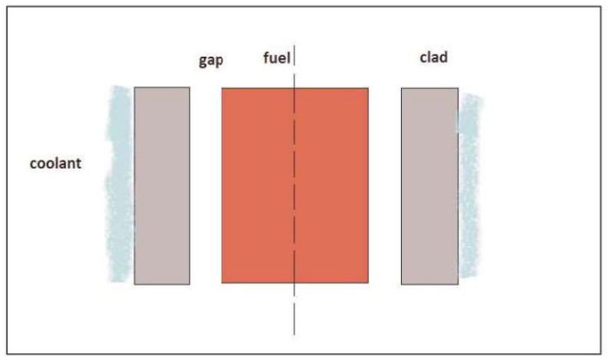
Radial Heat conduction in nuclear fuel elements
Reactor fuel pin is a cylindrical fuel element that contain fuel pellet, gap and cladding as shown in the Figure. Coolant can be in single phase or two phase. Fuel and clad properties are available as a function of temperature. The state of the coolant is obtained from convection equations. Thus, the information is provided by these to transient conduction solver. As the equation is non-linear due to complex property and boundary conditions, numerical solutions are called for.

Slide 3
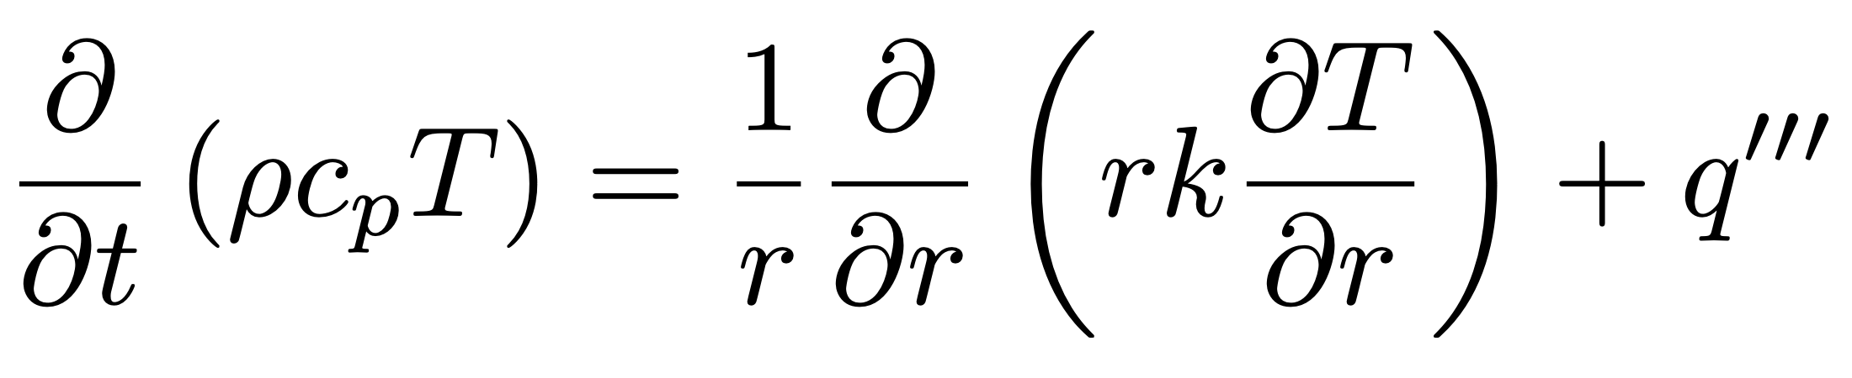
Basic governing equation (after Over assumption of azimuthal symmetry and neglecting axial conduction affects )

Slide 4
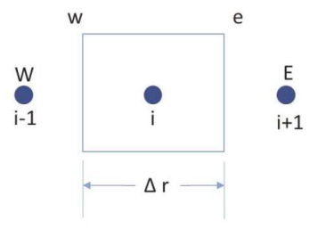
Discretized equations for fuel pin geometry (using finite volume approach)
In this section, the governing equation (shown in the previous slide) is integrated over volume and time at node_{i} to obtain the discretized equations.

Slide 5
Transient Term
$$∫_{w}^{e}∫_{t}^{t+Δt}\frac{∂}{∂t}\left(ρc_{p}T\right)rdrdt=Δr_{i}r_{i}[(ρc_{p}T_{i}^{n+1})−(ρc_{p}T_{i}^{n})]$$
T_{i}^{n+1}, T_{i+1}^{n} represents average values in the control volume at n+1th and n^{th} timesteps at i^{th} node location.

Slide 6
Conduction Term
$$∫_{w}^{e}∫_{t}^{t+Δt}(1/r)\frac{∂}{∂t}\left(rk\frac{∂}{∂r}\left(T\right)\right)rdrdt=\left(\left(\frac{r_{i+1}^{n+1}k_{i+1}^{n+1}}{Δr_{i+1}^{n+1}}\left(T_{i+1}^{n+1}−T_{i}^{n+1}\right)\right)−\left(\frac{r_{i−1}^{n+1}k_{i−1}^{n+1}}{Δr_{i−1}^{n+1}}\left(T_{i}^{n+1}−T_{i−1}^{n+1}\right)\right)\right)$$
T_{i}^{n+1}, T_{i+1}^{n} represents average values in the control volume at n+1th and n^{th} timesteps at i^{th} node location.

Slide 7
Heat Generation Term
$$∫_{w}^{e}∫_{t}^{t+Δt}q^{′′′}rdrdt=(q_{i}^{′′′})^{n+1}Δt\left(\frac{r_{i+1}^{2}−r_{i−1}^{2}}{2}\right)=(q_{i}^{′′′})^{n+1}r_{i}Δr_{i}Δt$$
T_{i}^{n+1}, T_{i+1}^{n} represents average values in the control volume at n+1th and n^{th} timesteps at i^{th} node location.

Slide 8
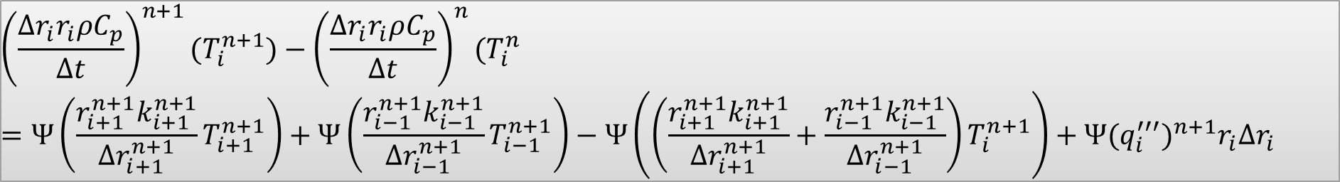
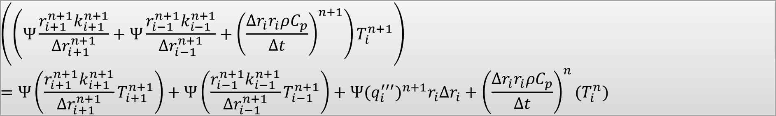
Substituting the discretization in the Governing Equation:
$$∫_{w}^{e}∫_{t}^{t+Δt}\frac{∂}{∂t}\left(ρc_{p}T\right)rdrdt=Ψ\left(∫_{w}^{e}∫_{t}^{t+Δt}(1/r)\frac{∂}{∂t}\left(rk\frac{∂}{∂r}\left(T\right)\right)rdrdt−∫_{w}^{e}∫_{t}^{t+Δt}q^{′′′}rdrdt\right)$$
$${\left(\frac{Δr_{i}r_{i}ρC_{p}}{Δt}\right)}^{n+1}(T_{i}^{n+1})−{\left(\frac{Δr_{i}r_{i}ρC_{p}}{Δt}\right)}^{n}(T_{i}^{n}=Ψ\left(\frac{r_{i+1}^{n+1}k_{i+1}^{n+1}}{Δr_{i+1}^{n+1}}T_{i+1}^{n+1}\right)+Ψ\left(\frac{r_{i−1}^{n+1}k_{i−1}^{n+1}}{Δr_{i−1}^{n+1}}T_{i−1}^{n+1}\right)−Ψ\left(\left(\frac{r_{i+1}^{n+1}k_{i+1}^{n+1}}{Δr_{i+1}^{n+1}}+\frac{r_{i−1}^{n+1}k_{i−1}^{n+1}}{Δr_{i−1}^{n+1}}\right)T_{i}^{n+1}\right)+Ψ(q_{i}^{′′′})^{n+1}r_{i}Δr_{i}$$
$$\left(\left(Ψ\frac{r_{i+1}^{n+1}k_{i+1}^{n+1}}{Δr_{i+1}^{n+1}}+Ψ\frac{r_{i−1}^{n+1}k_{i−1}^{n+1}}{Δr_{i−1}^{n+1}}+{\left(\frac{Δr_{i}r_{i}ρC_{p}}{Δt}\right)}^{n+1}\right)T_{i}^{n+1}\right)$$
$$=Ψ\left(\frac{r_{i+1}^{n+1}k_{i+1}^{n+1}}{Δr_{i+1}^{n+1}}T_{i+1}^{n+1}\right)+Ψ\left(\frac{r_{i−1}^{n+1}k_{i−1}^{n+1}}{Δr_{i−1}^{n+1}}T_{i−1}^{n+1}\right)+Ψ(q_{i}^{′′′})^{n+1}r_{i}Δr_{i}+{\left(\frac{Δr_{i}r_{i}ρC_{p}}{Δt}\right)}^{n}(T_{i}^{n})$$
Final Equation:
$$[CAP]T_{i}^{n+1}=[CAE]T_{i+1}^{n+1}+[CAW]T_{i−1}^{n+1}+S$$

Slide 9
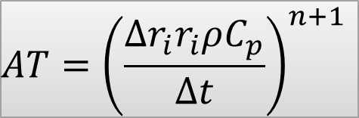
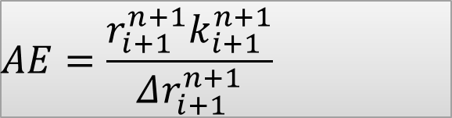


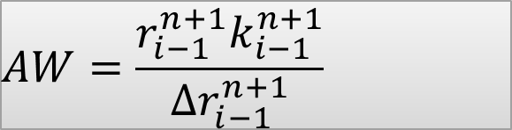





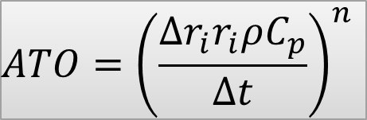
Final Equation:
$$[CAP]T_{i}^{n+1}=[CAE]T_{i+1}^{n+1}+[CAW]T_{i−1}^{n+1}+[S]$$
$$AW=\frac{r_{i−1}^{n+1}k_{i−1}^{n+1}}{Δr_{i−1}^{n+1}}$$
$$CAW=ΨAW$$
$$Ψ=\text{Implicit} \text{factor}$$
$$AE=\frac{r_{i+1}^{n+1}k_{i+1}^{n+1}}{Δr_{i+1}^{n+1}}$$
$$CAE=ΨAE$$
$$AQ=(q_{i}^{′′′})^{n+1}r_{i}Δr_{i}$$
$$CAQ=ΨAQ$$
$$CAP=CAW+CAE+AT$$
$$S=CAQ+ATO⋅T^{n}$$
$$AT={\left(\frac{Δr_{i}r_{i}ρC_{p}}{Δt}\right)}^{n+1}$$
$$ATO={\left(\frac{Δr_{i}r_{i}ρC_{p}}{Δt}\right)}^{n}$$

Slide 10

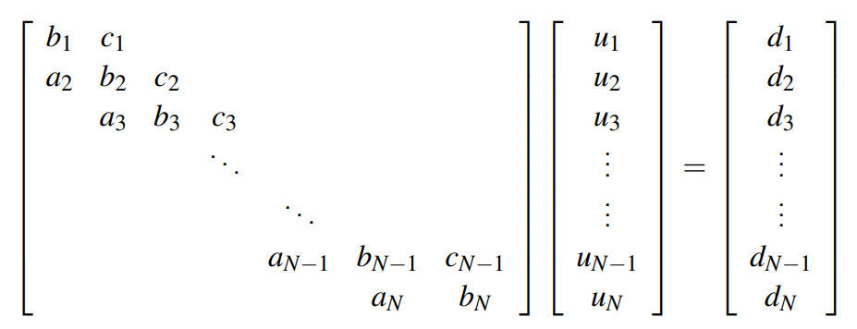

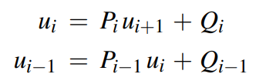




TDMA in CFD:
$$a_{i}=−\left[CAW\right]$$
$$d_{i}=+[S]$$
$$c_{i}=−[CAE]$$
$$b_{i}=+[CAP]$$

Slide 11
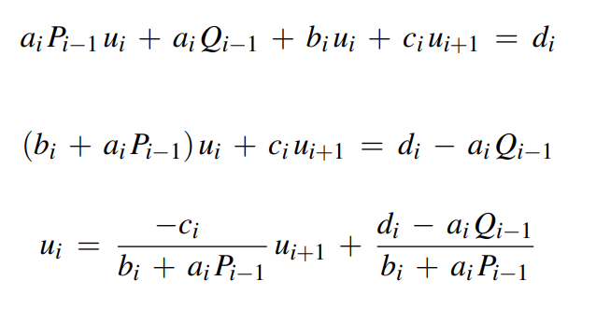
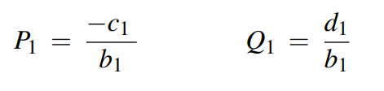
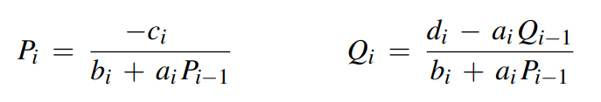

Slide 12
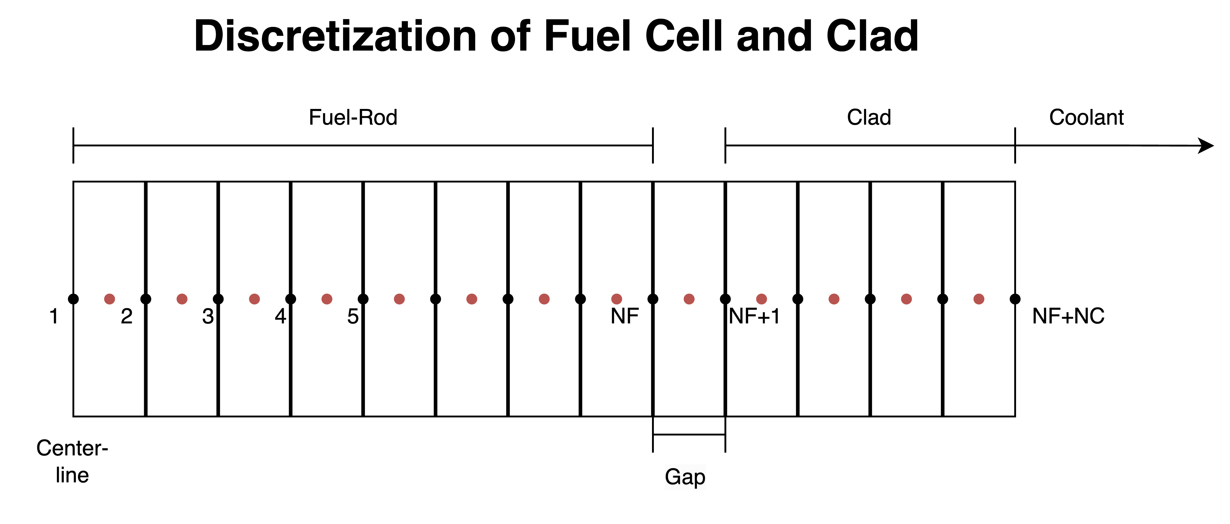



$$T_{inf}$$
$$T_{1}$$
$$T_{NF+NC}$$
NF = no. of fuel-cell divisions
NC = no. of clad-divisions
NT = NF + NC

Slide 13

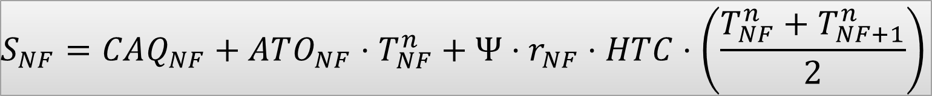
Boundary Conditions
At Centre-line in Fuel Rod (Neumann Left Boundary Condition)
$$CAW_{1}=0$$
$$S_{1}=CAQ_{1}+ATO_{1}⋅T_{1}^{n}+Ψ⋅r_{1}⋅q^{′′′}$$
At Fuel-Gap Surface (Robin’s Right Boundary Condition)
$$CAE_{NF}=ΨAE_{NF}+Ψ⋅r_{NF}⋅HTC$$
HTC = Heat-Transfer Coefficient for fuel-gap-clad
$$CAP_{NF}=CAW_{NF}+CAE_{NF}+AT_{NF}+Ψ⋅r_{NF}⋅HTC$$
$$S_{NF}=CAQ_{NF}+ATO_{NF}⋅T_{NF}^{n}+Ψ⋅r_{NF}⋅HTC⋅\left(\frac{T_{NF}^{n}+T_{NF+1}^{n}}{2}\right)$$

Slide 14

At Gap-Clad Surface (Robin’s Left Boundary Condition)
$$CAW_{NF+1}=ΨAW_{NF+1}+Ψ⋅r_{NF+1}⋅HTC$$
$$CAP_{NF+1}=CAW_{NF+1}+CAE_{NF+1}+AT_{NF+1}+Ψ⋅r_{NF+1}⋅HTC$$
$$S_{NF+1}=CAQ_{NF+1}+ATO_{NF+1}⋅T_{NF+1}^{n}+Ψ⋅r_{NF+1}⋅HTC⋅\left(\frac{T_{NF}^{n}+T_{NF+1}^{n}}{2}\right)$$
At Clad-Coolant Surface (Robin’s Right Boundary Condition)
$$CAE_{NF+NC}=0$$
HTCC = Heat-Transfer Coefficient for clad-coolant
T_{inf} = Temperature of Coolant
$$CAP_{NF+NC}=CAW_{NF+NC}+CAE_{NF+NC}+AT_{NF+NC}+Ψ⋅r_{NF}⋅HTCC$$
$$S_{NF+NC}=CAQ_{NF+NC}+ATO_{NF+NC}⋅T_{NF+NC}^{n}+Ψ⋅r_{NF+NC}⋅HTCC⋅T_{inf}$$

Slide 15
Data used for computation
Fuel Rod material = UO₂ (K_{f} = 2.5 W/m-K)
Clad material = Zircalloy-2 (K_{c} = 21.5 W/m-K)
Radius of Fuel Pin = 0.012 m
Inner Radius of Clad = 0.015 m
Outer Radius of Clad = 0.021 m
Number of domains in Fuel Rod = 13
(Number of Pesudo-Nodes for gap = 1)
Number of domains in Clad = 8
Density of Fuel Rod = 18900 kg/m³
Density of Clad = 6510 kg/m³
Specific Heat Capacity of Fuel Rod = 120 J/kg-K
Specific Heat Capacity of Clad = 270 J/kg-K
T_{inf} = 400K
Heat Transfer Coefficient (Fuel-Gap-Clad) = 7800 W/m²-K
Heat Transfer Coefficient (Clad-Coolant) = 3840 W/m²-K
Delta T (for Transient) = 0.1 s

Slide 16
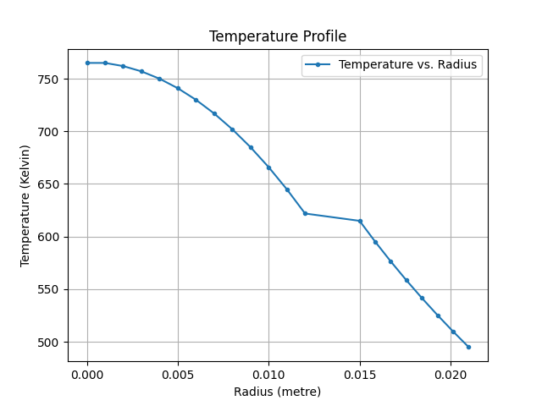
Steady State Temperature Profile

Slide 17
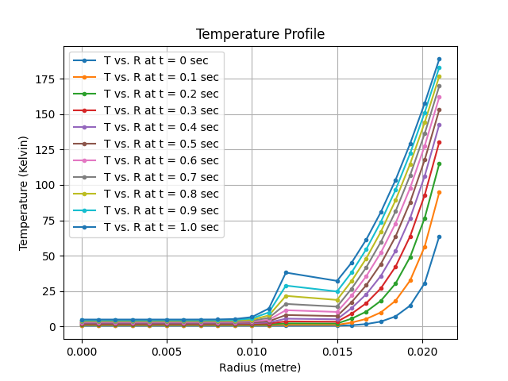
Transient State Temperature Profile

Slide 18
Thank You!

